Slide 1

Language Generation with Neural Networks
Eric Zander | LinkedIn

Slide 2
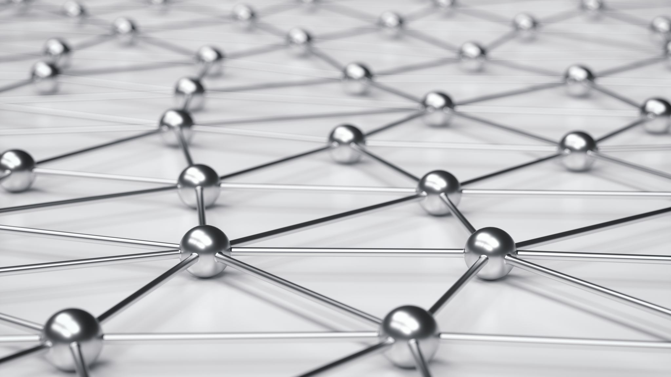
Neural Networks

Slide 3
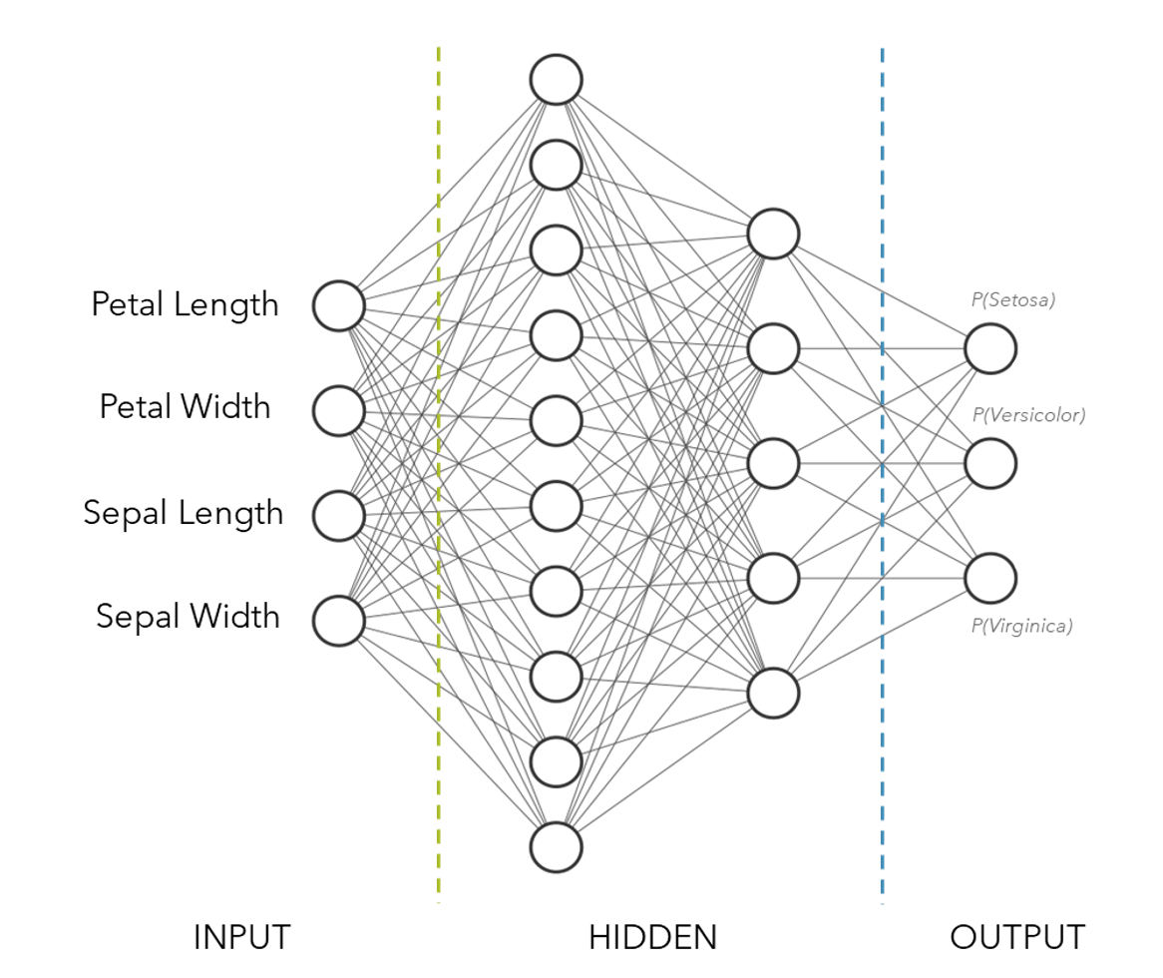

Slide 4

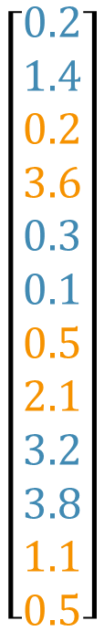







Embedding
Transforming words into numbers
Usually vectors of scalars
Many approaches
Dictionary
One-hot
Neural network
Word2Vec
ELMo
Transformer-based
$$\left[\begin{aligned}0.2 \\ 1.4 \\ 0.2 \\ 3.6 \\ 0.3 \\ 0.1 \\ 0.5 \\ 2.1 \\ 3.2 \\ 3.8 \\ 1.1 \\ 0.5\end{aligned}\right]$$
$$\left[\begin{aligned}hello \\ , \\ how \\ are \\ you \\ ?\end{aligned}\right]$$

Slide 6
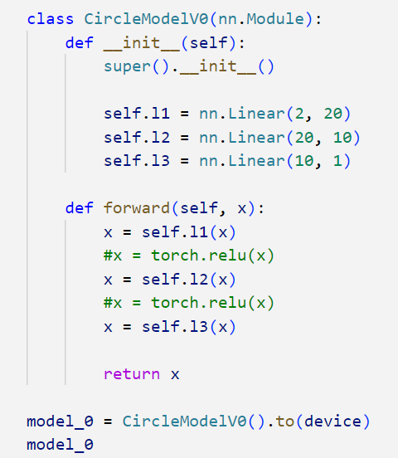
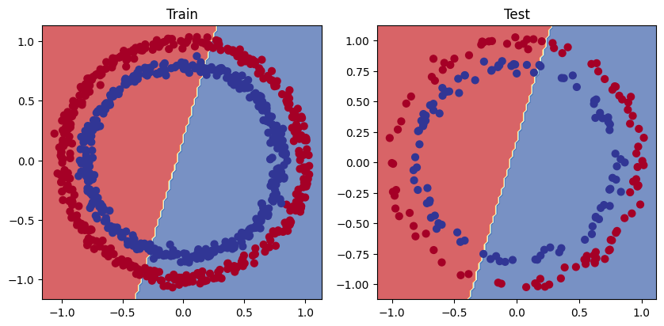
Nonlinearity
Using code by Daniel Bourke

Slide 7
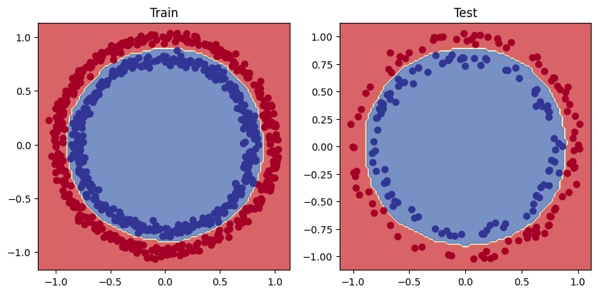
Nonlinearity
Using code by Daniel Bourke

Slide 9
[8, 7, 2, 4, 5, 3, 2, 1]

Slide 10
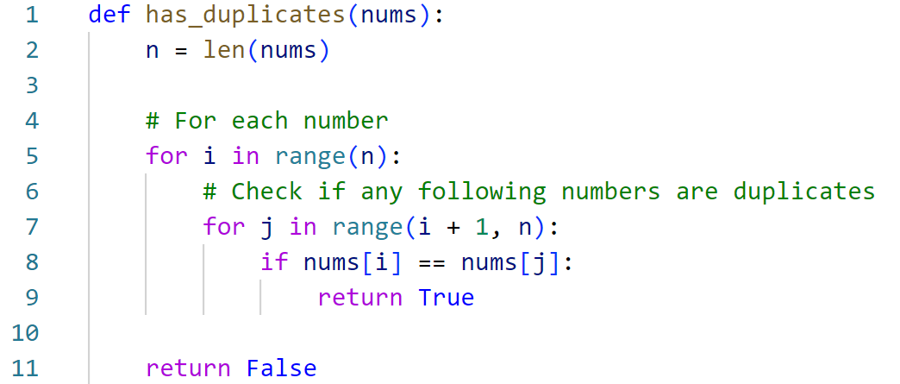
[8, 7, 2, 4, 5, 3, 2, 1]
O(n²)

Slide 11
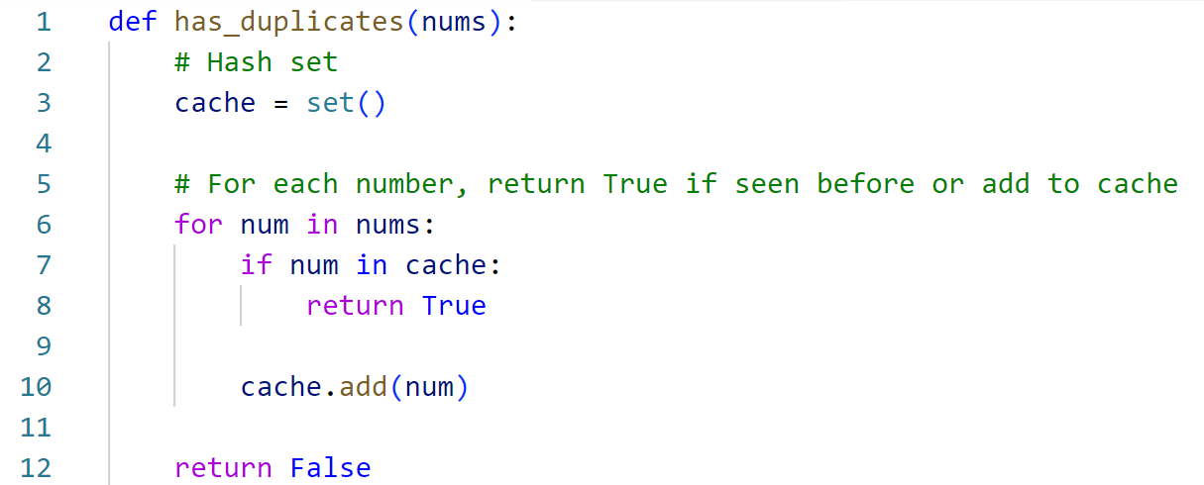
[8, 7, 2, 4, 5, 3, 2, 1]
O(n)

Slide 13
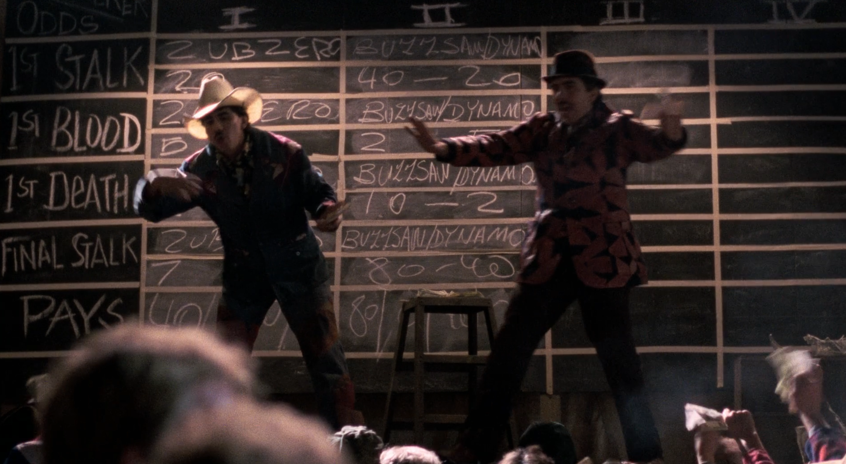
Probability, Odds, and Logits

Slide 14
Probability
[0, 1]
0.8
0.2

Slide 15
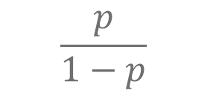
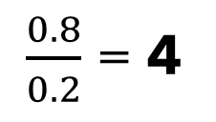
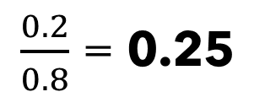
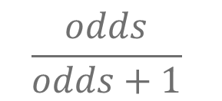
Probability
Odds
[0, 1]
[0, ∞)
$$\frac{p}{1−p}$$
0.8
$\frac{0.8}{0.2}$ = 4
0.2
$\frac{0.2}{0.8}$ = 0.25
$$\frac{odds}{odds+1}$$

Slide 16

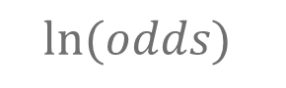
Probability
Odds
Logits
[0, 1]
[0, ∞)
(-∞, ∞)
$$\frac{p}{1−p}$$
$$ln⁡(odds)$$
0.8
$\frac{0.8}{0.2}$ = 4
~1.4
0.2
$\frac{0.2}{0.8}$ = 0.25
~-1.4
$$\frac{odds}{odds+1}$$
$$elogit$$

Slide 17
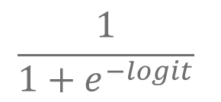
Probability
Odds
Logits
[0, 1]
[0, ∞)
(-∞, ∞)
$$\frac{p}{1−p}$$
$$ln⁡(odds)$$
0.8
$\frac{0.8}{0.2}$ = 4
~1.4
0.2
$\frac{0.2}{0.8}$ = 0.25
~-1.4
$$\frac{odds}{odds+1}$$
$$elogit$$
$$\frac{1}{1+e^{−logit}}$$

Slide 18
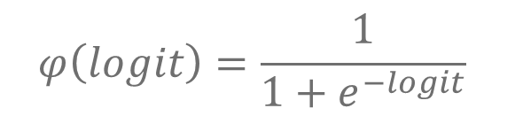
Probability
Odds
Logits
[0, 1]
[0, ∞)
(-∞, ∞)
$$\frac{p}{1−p}$$
$$ln⁡(odds)$$
0.8
$\frac{0.8}{0.2}$ = 4
~1.4
0.2
$\frac{0.2}{0.8}$ = 0.25
~-1.4
$$\frac{odds}{odds+1}$$
$$elogit$$
$$φ\left(logit\right)=\frac{1}{1+e^{−logit}}$$
Sigmoid Function!

Slide 19

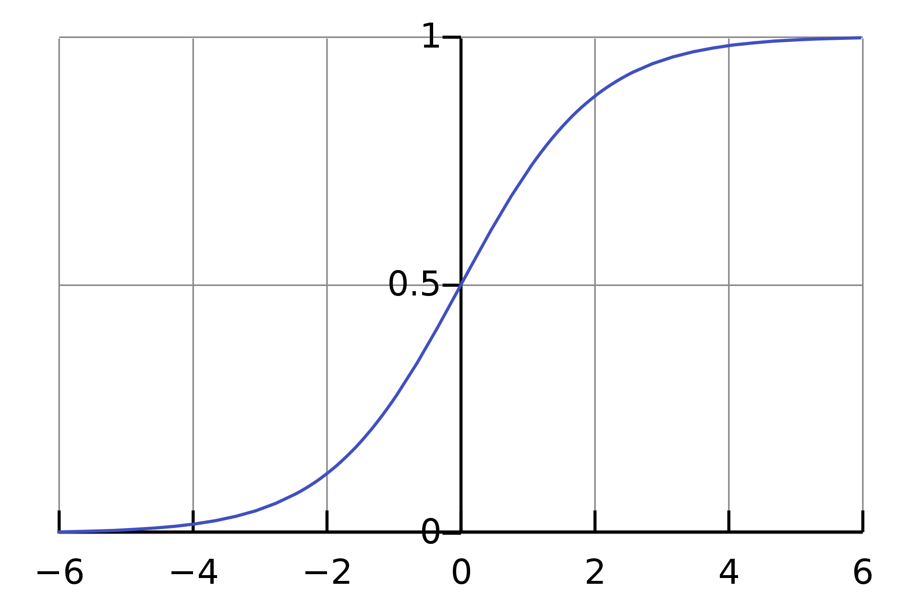
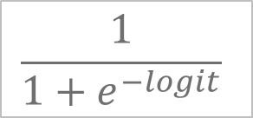
Sigmoid Activation
$$\frac{1}{1+e^{−logit}}$$
Converts a logit to a probability
Used for binary classification output
Comparable to logistic regression

Slide 20
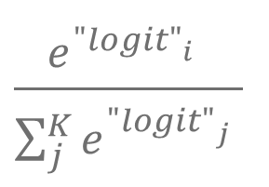


Probability
Odds
Logits
[0, 1]
[0, ∞)
(-∞, ∞)
$$\frac{p}{1−p}$$
$$ln⁡(odds)$$
0.8
$\frac{0.8}{0.2}$ = 4
~1.4
0.2
$\frac{0.2}{0.8}$ = 0.25
~-1.4
$$\frac{odds}{odds+1}$$
$$elogit$$
Softmax function?
$$\frac{e^{{"logit"}_{i}^{}}}{\sum_{j}^{K}{e^{{"logit"}_{j}^{}}}}$$

Slide 22

Problem Variable Length Input?

Slide 23
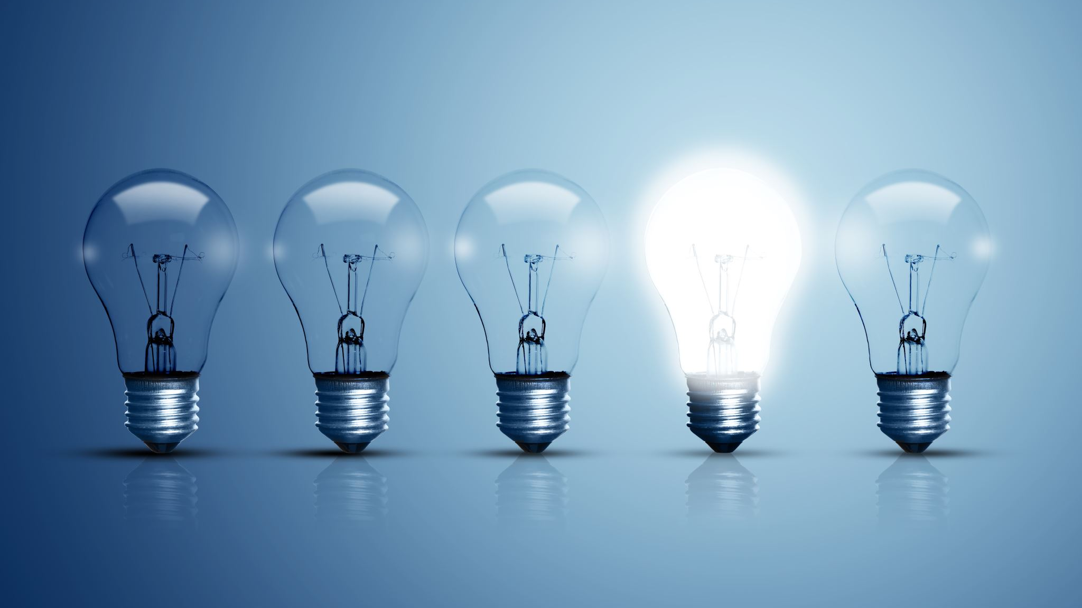
Recurrent Neural Networks (RNNs)

Slide 24

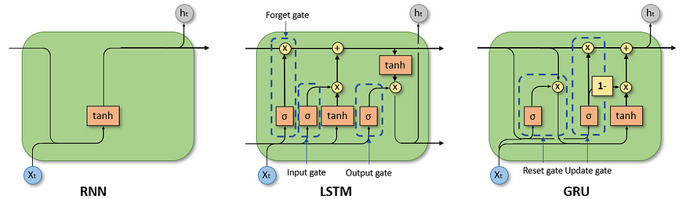
Recurrent Neural Networks (RNN)
Left: A recurrent neural network takes input vector x and gives output vector o by processing each input and an updated hidden state h
By fdeloche - Own work, CC BY-SA 4.0
Right: To combat vanishing gradients for longer sequences, Long Short-Term Memory (LSTM) units or Gated Recurrent Units (GRU) can be used appropriately supplement the hidden state
Input &
Hidden State
Input, Cell State, &
Hidden State
Input &
Hidden State
Dancker, 2022

Slide 25
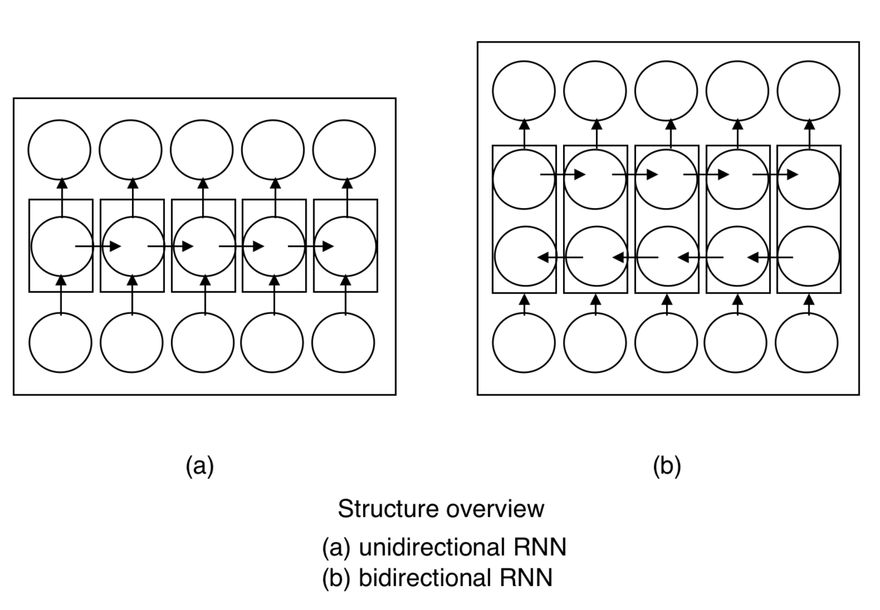
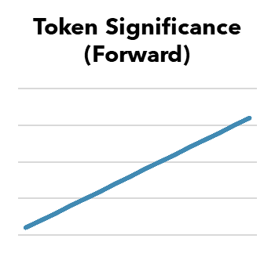
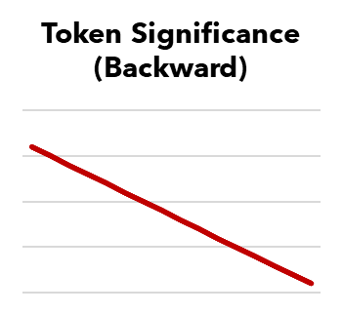
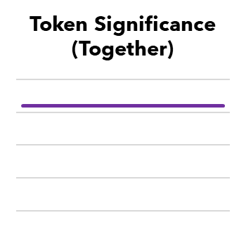
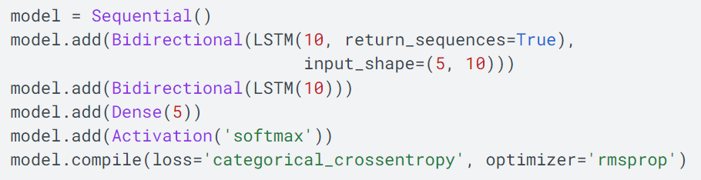
Bidirectional RNNs
+
By Incfk8 - Own work, CC BY-SA 4.0
=
TensorFlow implementation

Slide 26

Problem Variable Length Output & Causality

Slide 27
Example: Translation
Hello
,
how
are
you
?
Ciao
,
come
stai
?
Model

Slide 28

Language Generation

Slide 29
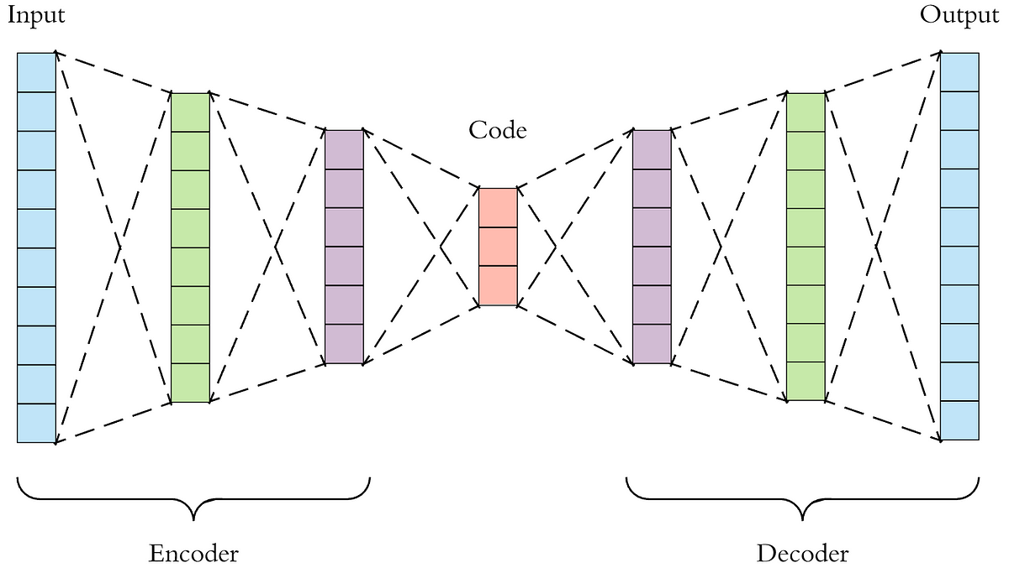
Autoencoders? VAEs?
Dertat, 2017

Slide 30
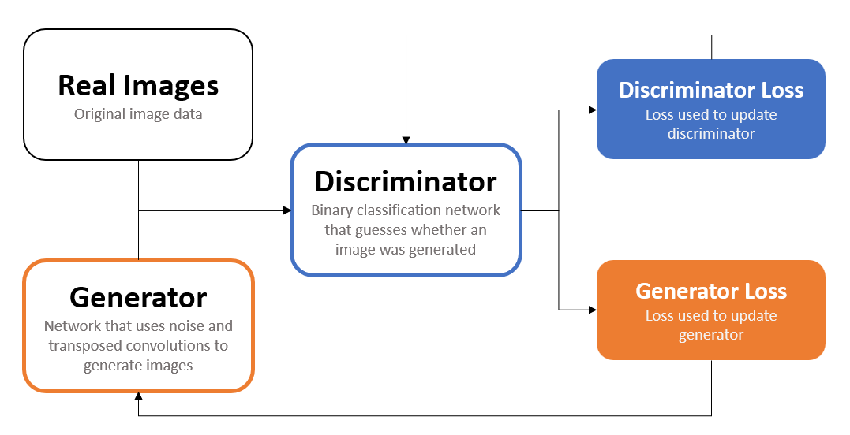
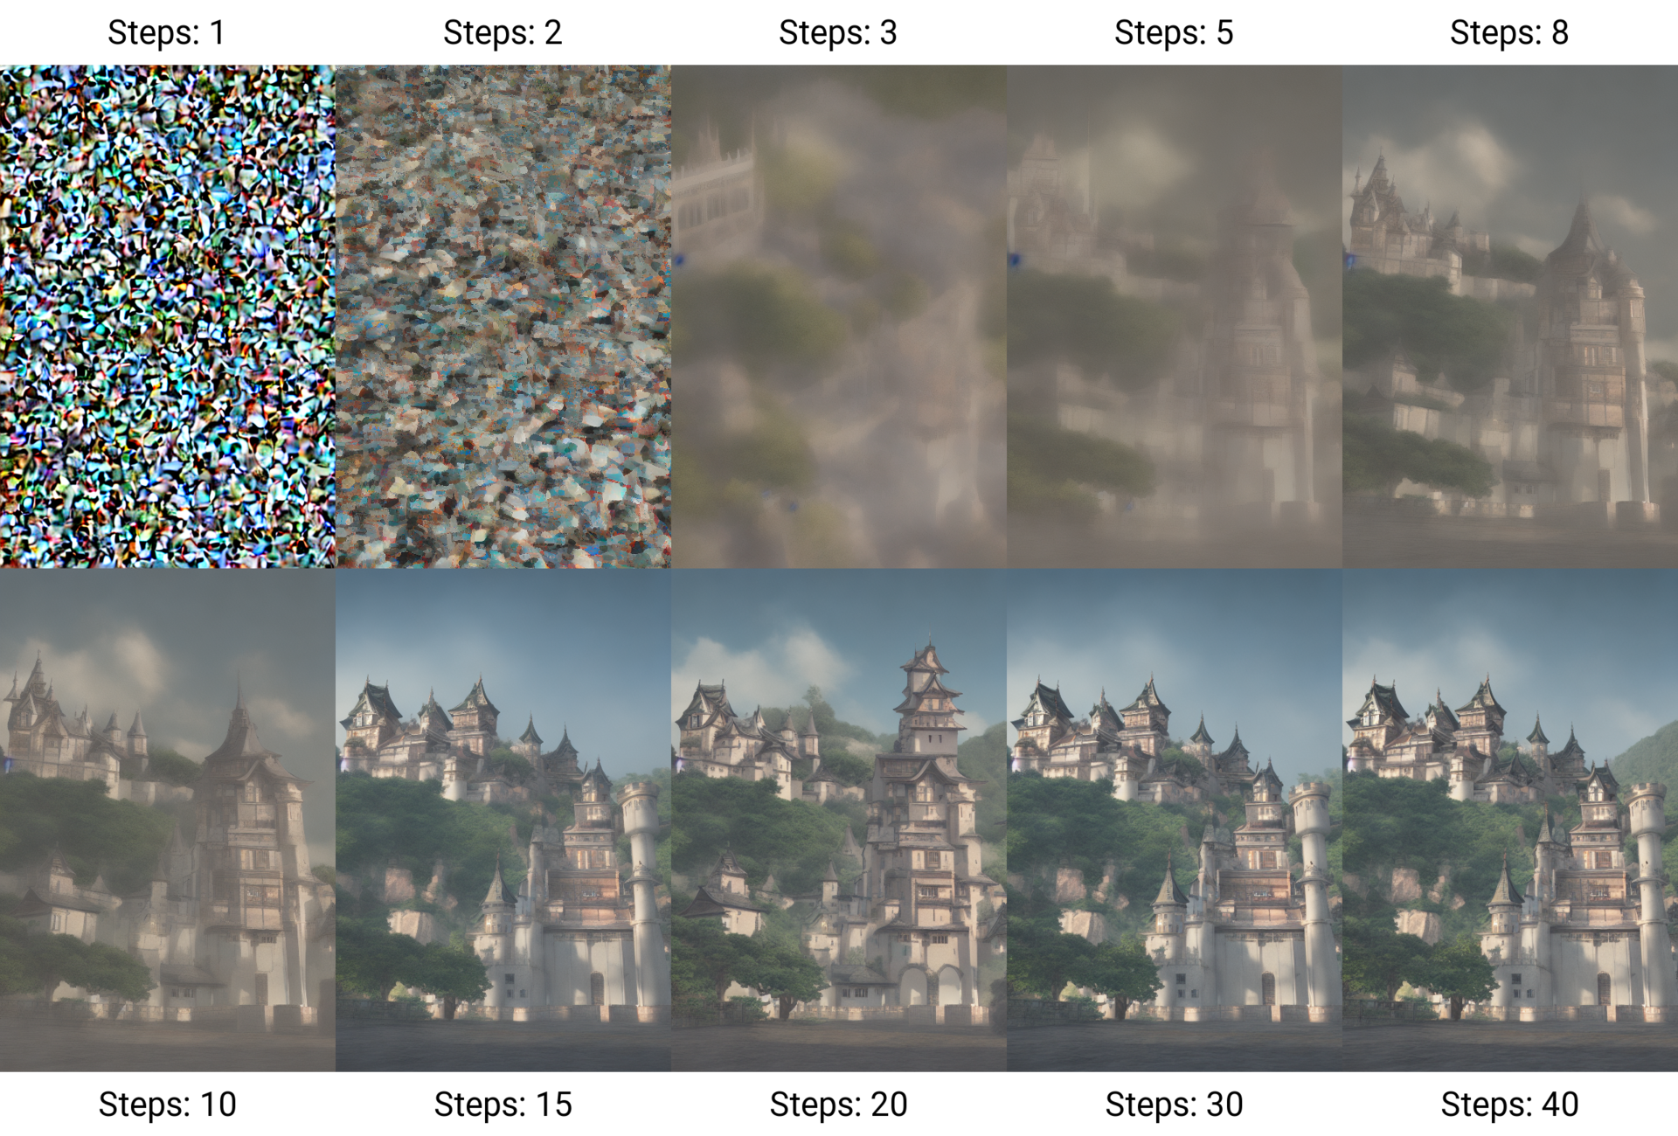
GANs? Diffusion Models?
Above: Flowchart describing the training of a Generative Adversarial Network (GAN)
Right: Illustration of the denoising process underlying diffusion models.
By Benlisquare - Own work, CC BY-SA 4.0

Slide 31
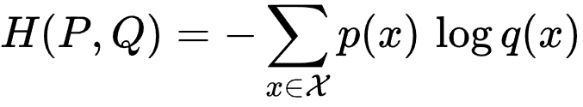
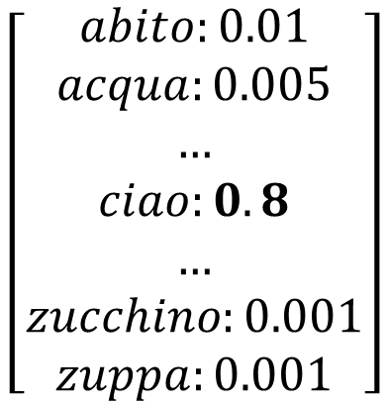
Actually… Classification (sort of)
Possible value comparison
Pixel intensity (8-bit RGB)
256³ = 16,777,216 values
English words
~170,000 (in current use)
Pretty large compared to other languages
There are several tricks for reducing vocabulary
Tokenization methods (ex. BPE), lemmatization, etc.
Otherwise, use brute force
Big models
Big datasets
Big investment
Technically, this is a method of language modeling rather than classification
$$\left[\begin{aligned}abito:0.01 \\ acqua:0.005 \\ … \\ ciao:0.8 \\ … \\ zucchino:0.001 \\ zuppa:0.001\end{aligned}\right]$$

Slide 32
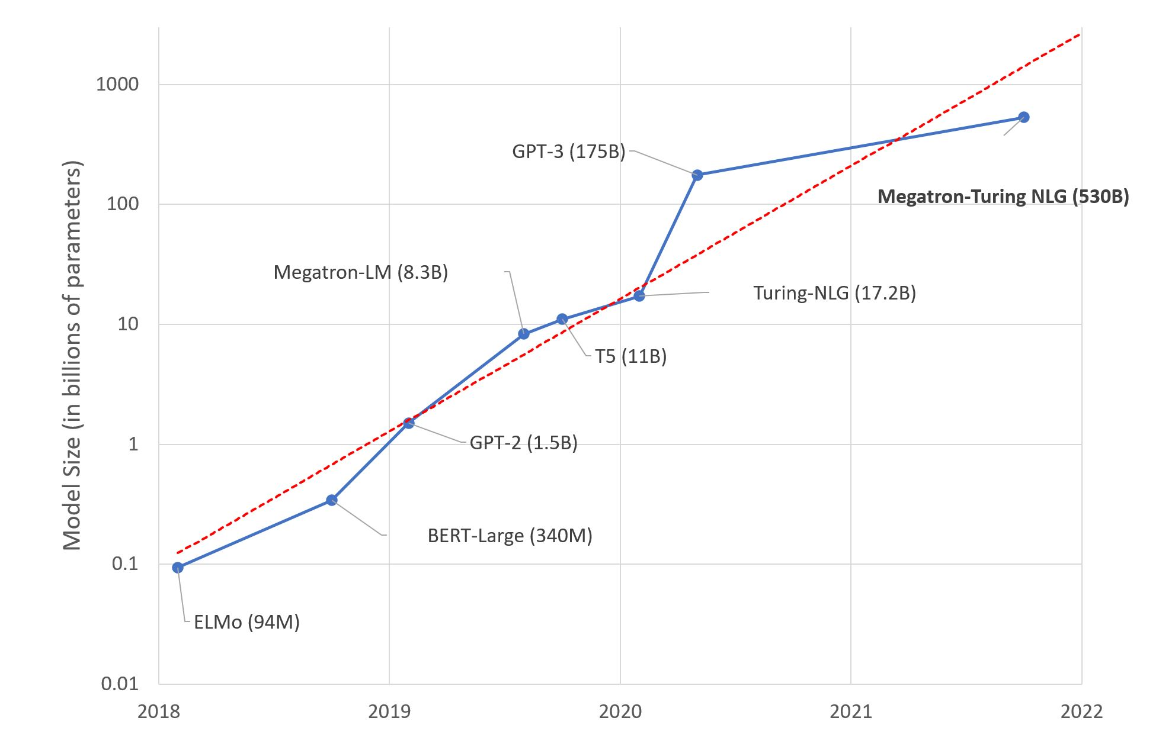
Large Language Models: A New Moore’s Law?
Simon, Hugging Face, 2021

Slide 33




Encoder-Decoders!
Transformer architecture,
Vaswani et al., 2016

Slide 34












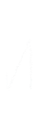

















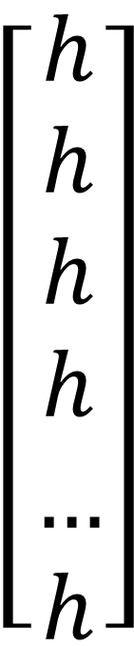
Encoding (RNN)
Example
$$\left[\begin{aligned}h \\ h \\ h \\ h \\ … \\ h\end{aligned}\right]$$
Hello
,
how
are
you
?
Encoded ← Input
Dertat, 2 |

Slide 35
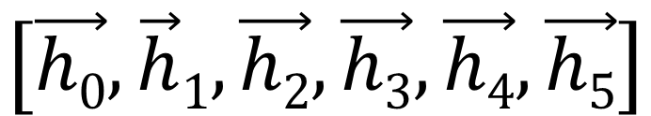
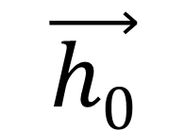
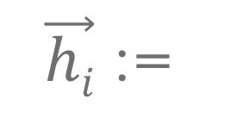
Preparing to Decode (RNN)
Encoded Input
Hidden State
$$\left[\vec{h0},\vec{h}1,\vec{h2},\vec{h3},\vec{h4},\vec{h5}\right]$$
$$\vec{h0}$$
“Hello , how are you ?”
(start with final input state)
Input
(i.e. Previous Output)
Hidden states (scalars) for each recurrent unit at the i^{th} time step
$\vec{hi}$ :=
<BOS>
(dummy starting token)

Slide 36





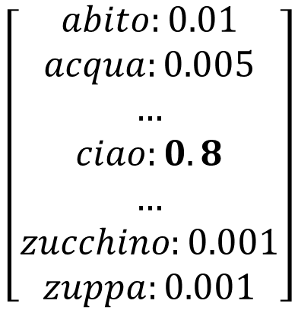
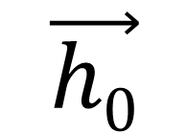






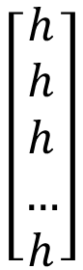
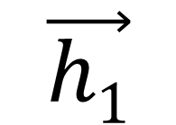











Decoding (RNN)
$$\left[\begin{aligned}h \\ h \\ h \\ … \\ h\end{aligned}\right]$$
$$\vec{h0}$$
$$\vec{h1}$$
$$\left[\begin{aligned}abito:0.01 \\ acqua:0.005 \\ … \\ ciao:0.8 \\ … \\ zucchino:0.001 \\ zuppa:0.001\end{aligned}\right]$$
<BOS>
ciao
“Hello , how are you ?”
“<BOS>”

Slide 37





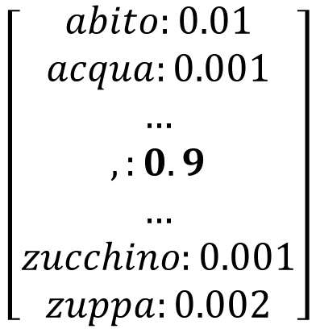
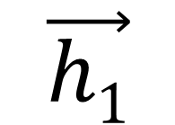






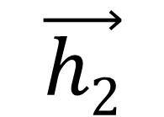











Decoding (RNN)
$$\left[\begin{aligned}h \\ h \\ h \\ … \\ h\end{aligned}\right]$$
$$\vec{h1}$$
$$\vec{h2}$$
$$\left[\begin{aligned}abito:0.01 \\ acqua:0.001 \\ … \\ ,:0.9 \\ … \\ zucchino:0.001 \\ zuppa:0.002\end{aligned}\right]$$
ciao
,
“Hello , how are you ?”
“<BOS> ciao”

Slide 38
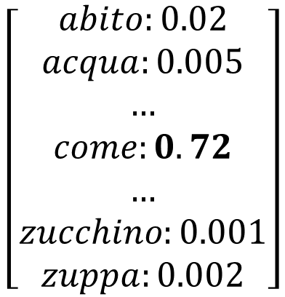
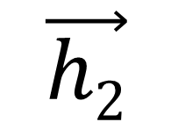
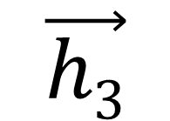
Decoding (RNN)
$$\left[\begin{aligned}h \\ h \\ h \\ … \\ h\end{aligned}\right]$$
$$\vec{h2}$$
$$\vec{h3}$$
$$\left[\begin{aligned}abito:0.02 \\ acqua:0.005 \\ … \\ come:0.72 \\ … \\ zucchino:0.001 \\ zuppa:0.002\end{aligned}\right]$$
,
come
“Hello , how are you ?”
“<BOS> ciao , ”

Slide 39
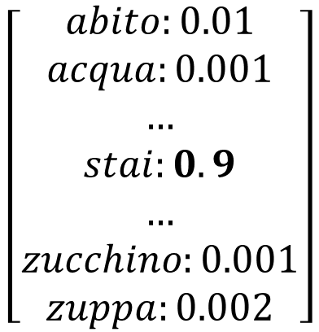
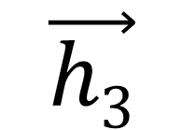
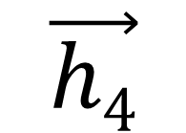
Decoding (RNN)
$$\left[\begin{aligned}h \\ h \\ h \\ … \\ h\end{aligned}\right]$$
$$\vec{h3}$$
$$\vec{h4}$$
$$\left[\begin{aligned}abito:0.01 \\ acqua:0.001 \\ … \\ stai:0.9 \\ … \\ zucchino:0.001 \\ zuppa:0.002\end{aligned}\right]$$
come
stai
“Hello , how are you ?”
“<BOS> ciao , come”

Slide 40



Decoding (RNN)
$$\left[\begin{aligned}h \\ h \\ h \\ … \\ h\end{aligned}\right]$$
$$\vec{h4}$$
$$\vec{h5}$$
$$\left[\begin{aligned}abito:0.011 \\ acqua:0.007 \\ … \\ ?:0.95 \\ … \\ zucchino:0.001 \\ zuppa:0.01\end{aligned}\right]$$
stai
?
“Hello , how are you ?”
“<BOS> ciao , come stai”

Slide 41



Decoding (RNN)
$$\left[\begin{aligned}h \\ h \\ h \\ … \\ h\end{aligned}\right]$$
$$\vec{h5}$$
$$\vec{h6}$$
$$\left[\begin{aligned}abito:0.001 \\ acqua:0.002 \\ … \\ <EOS>:0.9 \\ … \\ zucchino:0.001 \\ zuppa:0.01\end{aligned}\right]$$
?
<EOS>
“Hello , how are you ?”
“<BOS> ciao , come stai ?”

Slide 42

Another Example
Zhang et al., 2021

Slide 43
seq2seq
Umbrella term for this encoder-decoder framework
Applications
Translation
Speech recognition
Text summarization
Code translation/generation
Image captioning
RNN-based models have some limitations
Difficulties with long-range dependencies
Issues with scalability (sequential processing of input)

Slide 44




Transformers: more than meets the eye
Transformer architecture,
Vaswani et al., 2016

Slide 45

Positional Encoding

Slide 46





1st
2nd
3rd
Transformer Neural Networks, ChatGPT’s foundation, Clearly Explained!!!,
StatQuest with Josh Starmer, YouTube, 2023

Slide 47

Attention
Mechanism for prioritizing information
Uses simple matrix multiplications
Highly parallelized
Supports some explainability techniques
Can be used in many contexts
With RNNs
On its own
Non-NLP tasks
Attention heatmap,
Bandanau et al., 2015

Slide 48


Keys, Values, and Queries
Keys (K)
Represents inputs (form)
Values (V)
Represents inputs (content)
Queries (Q)
Element for which attention needs to be calculated
K
V
Q
Encoder self-attention
K
V
Q
Decoder cross-attention

Slide 49













Slide 50




































































Projection Matrices
(Learned Network Weights)

Slide 51








Attention Scores
(Scaled Dot Products)
Projection Matrices
(Learned Network Weights)

Slide 52






























































































Attention Scores
(Scaled Dot Products)
Projection Matrices
(Learned Network Weights)
Attention Weights
(Softmax)

Slide 53
















Attention Scores
(Scaled Dot Products)
Projection Matrices
(Learned Network Weights)
Attention Weights
(Softmax)
Context Vector
(Weighted Sum)

Slide 54


$$Attention\left(Q, K, V\right)=softmax\left(\frac{QK^{T}}{\sqrt{dk}}\right)V$$
Attention is All You Need, Vaswani et al., 2016

Slide 55

Attention in Transformers
Self-attention
K, V, Q from one source
Cross-attention
Q from different source
Multi-head attention
Repeats process with different weights
Produces multiple context vectors
Masked attention
Limits attention to certain tokens
Useful for training in parallel
No looking ahead
By DancingPhilosopher - Own work, CC BY-SA 4.0

Slide 56


Transformers: more than meets the eye
Transformer architecture,
Vaswani et al., 2016

Slide 57

Pretraining and Fine-Tuning

Slide 58
Pre-training and Fine-Tuning
Pre-training
General language modelling
Usually unsupervised
Many parameters
Expensive
Fine-tuning
Task-specific
Usually supervised
Architecture modification
New output layer(s)
Existing layer changes

Slide 59

Generative Pretrained Transformer (GPT)
GPT-1’s decoder-only architecture, Radford et al., 2018
Next-word prediction
Decoder-only (GPT-1) and then full transformer
Unsupervised pre-training (language modelling)
Supervised fine-tuning

Slide 60

Bidirectional Encoder Representations from Transformers (BERT)
Encoder-only language models prominent in language understanding
Less of a focus on generation
Trains by predicting masked words based on surroundings
Can look forward as well as backward (bidirectional)
In addition to these predictions, the context vectors support…
Classification
Sentiment analysis
Semantic similarity
Embedding
Can require more fine-tuning than GPT
Not autoregressive
BERT architecture

Slide 61

Devlin et al., 2018

Slide 62

Reinforcement Learning from Human Feedback (RLHF)
Fine-tuning method used by models such as ChatGPT
Uses reward modelling with RL algorithms such as Proximal Policy Optimization (PPO)
Uses reward based on human preference
Uses KL divergence for constraint
Limits drift away from initial model

Slide 63


Rule-based Reward Models (RBRMs)
Training GPTs with GPTs
Like NLP-based classifiers
Useful for limiting undesirable content without training up a specific model
GPT-4 Technical Report, OpenAI, 2023

Slide 64

Thank you

Slide 65
References
J. Dancker. A Brief Introduction to Recurrent Neural Networks, https://towardsdatascience.com/a-brief-introduction-to-recurrent-neural-networks-638f64a61ff4
A. Dertat. Applied Deep Learning – Part 3: Autoencoders, https://towardsdatascience.com/applied-deep-learning-part-3-autoencoders-1c083af4d798
A. Vaswani et al., Attention Is All You Need. arXiv, 2017. doi: 10.48550/ARXIV.1706.03762.
I. Sutskever, O. Vinyals, and Q. V. Le, Sequence to Sequence Learning with Neural Networks. 2014.
A. Zhang, Z. C. Lipton, M. Li, and A. J. Smola, Dive into Deep Learning. 2021.
J. Starmer. Transformer Neural Networks, ChatGPT’s foundation, Clearly Explained!!! StatQuest with Josh Starmer. YouTube. 2023. https://www.youtube.com/watch?v=zxQyTK8quyY&ab_channel=StatQuestwithJoshStarmer
D. Bahdanau, K. Cho, and Y. Bengio, Neural Machine Translation by Jointly Learning to Align and Translate. 2016.
J. Simon. Large Language Models: A New Moore’s Law?, Hugging Face, 2021. https://huggingface.co/blog/large-language-models
A. Radford, K. Narasimhan, T. Salimans, I. Sutskever, and others, “Improving language understanding by generative pre-training,” 2018.
J. Devlin, M.-W. Chang, K. Lee, and K. Toutanova, BERT: Pre-training of Deep Bidirectional Transformers for Language Understanding. 2019.
N. Lambert, L. Castricato, L. von Werra, and A. Havrilla, “Illustrating Reinforcement Learning from Human Feedback (RLHF),” Hugging Face Blog, 2022. https://asouqi.github.io/bibtex-converter/
OpenAI, GPT-4 Technical Report. 2023.

